Slide 1
Project Risk Management

Slide 2
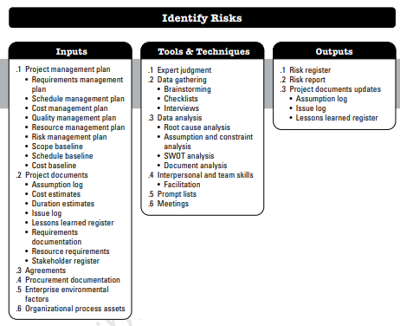
2 IDENTIFY RISKS
Identify Risks is the process of identifying individual project risks as well as sources of overall project risk, and documenting their characteristics.

Slide 3
SWOT Analysis
SWOT Analysis is a strategic tool used in project risk management to identify and analyse the Strengths, Weaknesses, Opportunities, and Threats associated with a project or organization.
It helps teams evaluate internal and external factors that could impact the project's success.
Components of SWOT Analysis:
1. Strengths: Internal attributes that give the project an advantage (e.g., skilled team, robust tools).
2. Weaknesses: Internal attributes that could hinder the project's success (e.g., lack of resources, skill gaps).
3. Opportunities: External factors or trends that the project can capitalize on (e.g., new market demand, emerging technologies).
4. Threats: External factors that could pose risks (e.g. regulatory changes).

Slide 4
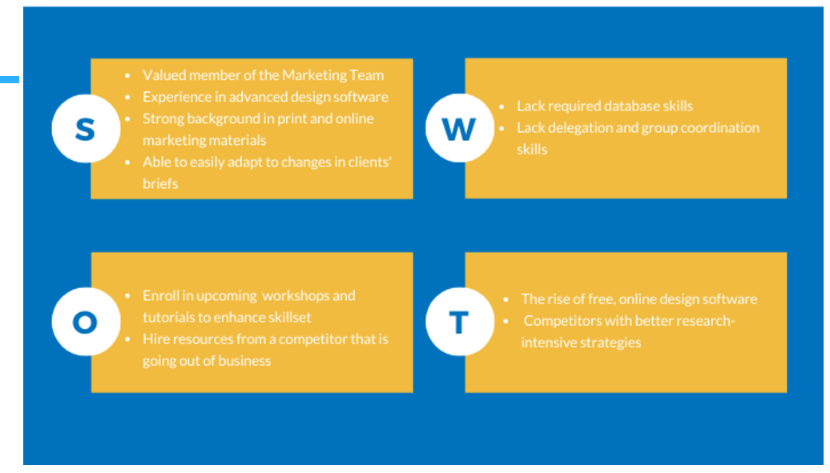
SWOT Analysis

Slide 5
Case Study: TechCore Solutions' E-learning Platform
TechCore Solutions, a start up specializing in technology-driven education, is developing an innovative AI-driven E-learning Platform designed to transform personalized learning. The platform analyses students’ learning patterns using advanced AI algorithms to deliver tailored content, gamified assessments, and real-time performance tracking. Collaborating closely with experienced educators, the development team aims to ensure high-quality and engaging educational content.
However, the project faces challenges. With limited financial resources, the company struggles to allocate sufficient funds for extensive testing and marketing. Additionally, the startup is working under a tight timeline, creating pressure on the team and increasing the risk of burnout. While the development team is highly skilled in AI technologies, they lack experience with large-scale platform deployment, which could impact scalability during launch.

Slide 6
Case Study: TechCore Solutions' E-learning Platform
Despite these internal challenges, the project is entering a promising market. Post-pandemic, there has been a surge in demand for e-learning platforms, with schools and universities seeking digital solutions. TechCore has an opportunity to partner with educational institutions and potentially secure government support for digital education initiatives. There is also increasing interest in gamified learning, which aligns perfectly with the platform’s features.
On the other hand, the market is competitive, with established players like Coursera and Khan Academy dominating the space. These competitors have strong brand recognition and established user bases, making it challenging for TechCore to gain traction. Additionally, the fast-paced advancements in AI technology pose a risk of obsolescence, and concerns about data privacy for students’ personal information could lead to regulatory challenges.
Perform a SWOT Analysis based on the case study.

Slide 7
Solution
Strengths:
Skilled AI Team
Unique AI- Driven Personalization features such as tailored content and gamified assessment.
Strong Collaboration with experienced educators ensuring high quality content.
Passionate leadership team committed to innovation.
Weaknesses:
Limited Financial Resources
Tight Project Deadline
Lack of experience in scaling AI based Platforms for large audience
Opportunities:
Increasing demand for e- learning platforms after the pandemic.
Potential Partnership with educational institutions.
Government Initiatives supporting digital education.
Expansion into International markets.
Threats:
Established Competitors
Data Privacy Concerns
Fast-paced advancements in AI technology

Slide 8
2 IDENTIFY RISKS
Output: Risk Register and Risk Report
The risk register is a document that captures all the identified risks along with their characteristics.
It is updated throughout the project life cycle. It is used by project team for daily risk management.
The risk report presents information on sources of overall project risk, together with summary information on identified individual project risks.
It evolves as risks are identified, analyzed and managed throughout the project.

Slide 9
Example
A company is launching a new e-commerce website to expand its online presence. The project involves designing the website, integrating payment systems, and ensuring scalability for high traffic. The target launch date is three months away.
During the planning phase, the team identifies the following risks:
1. Delayed delivery from the payment gateway vendor.
2. Server capacity issues during the launch phase.

Slide 10
Risk Register
Risk ID | Risk Description | Risk Category | Risk Owner | Trigger | Potential Response
R1 | Delay in Payment Gateway delivery | External | Vendor/ Manager | Vendor fails to meet delivery deadlines | Negotiate a backup vendor or agreement
R2 | Server Overload during launch | Technical | IT Team Lead. | High website traffic during promotional campaigns | Update Server capacity and run load testing

Slide 11
Risk Report
1. Sources of Overall Project Risk:
Dependency on third-party vendors and external systems.
Scalability challenges for the new website under high demand.
2. Key Individual Risks:
R1 (Payment Gateway Delay): Critical risk affecting the integration timeline and overall project delivery.
R2 (Server Overload): High potential to disrupt user experience during the launch, leading to reputational damage.
3. Risk Trends:
Vendor delays are a recurring issue in similar projects, highlighting the need for better vendor management.
Scalability risks are common in high-traffic launches but manageable with proactive measures like load testing.
4. Risk Implications:
R1: Delayed payment gateway could push back the project timeline by 2-3 weeks.
R2: Server capacity issues could result in downtime during peak traffic, affecting customer satisfaction and revenue.

Slide 12
Difference: Risk Register and Risk Report
Risk Register focuses on operational details such as risk triggers and potential responses, serving as a practical tool for the project team.
Risk Report provides a summarized, high-level analysis for stakeholders to understand the broader implications of risks and make strategic decisions.

Slide 13
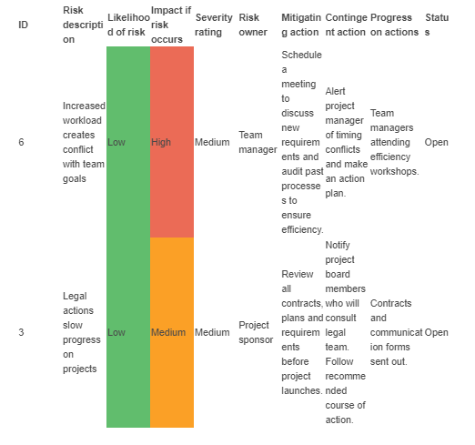
Example of Risk Register

Slide 14
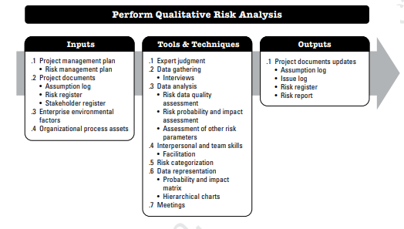
3 PERFORM QUALITATIVE RISK ANALYSIS
Perform Qualitative Risk Analysis is the process of prioritizing individual project risks for further analysis or action by assessing their probability of occurrence and impact as well as other characteristics.

Slide 15
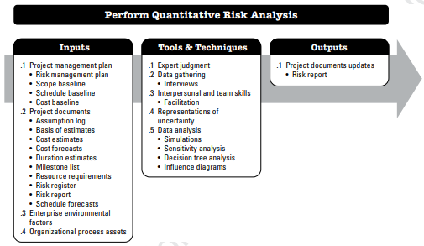
4 Perform Quantitative Risk Analysis
Perform Quantitative Risk Analysis is the process of numerically analyzing the impact of identified individual project risks on overall project objectives.

Slide 16
Quantitative Risk Analysis
Expected monetary value:
Expected Monetary Value (EMV) is a technique used in quantitative risk analysis to calculate the expected financial outcome of risks by multiplying their probability by their monetary impact.
EMV = P * I
Determine the probability (P) an outcome will occur.
Determine the monetary value or impact (I) of the outcome.
Multiply P x I to calculate the EMV.
Probability: Refers to the likelihood of a specific risk event occurring during the project’s execution. It is expressed as a percentage, ranging from 0% (no chance of occurrence) to 100% (certain to occur).
Impact: Represents the financial consequences of the risk event if it materializes. It is typically quantified in terms of monetary value, such as currency units, or dollars.

Slide 17
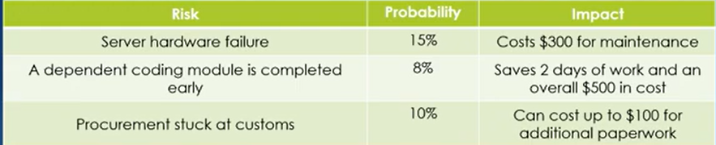
EMV Calculation Example

Slide 18
EMV Calculation Example
Risk 1: 15% * $300 = $45(-$45)
Risk 2: 8% * $500 = $40
Risk 3: 10% * $100 = $10(-$10)
Note that Risk 2 is opportunity.
Now add all these values for total EMV.
(-45)+40+(-10) = -15
This $15 is the extra money that you need to add to your budget to account for all the project risks.

Slide 19
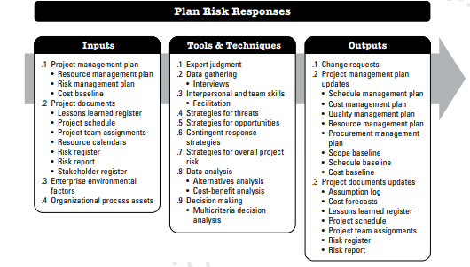
5 PLAN RISK RESPONSES
Plan Risk Responses is the process of developing options, selecting strategies, and agreeing on actions to address overall project risk exposure, as well as to treat individual project risks.

Slide 20
Strategies For Threats
The risk response strategies that are used to deal with individual project risks can also be applied to overall project risk:
Avoidance: Eliminate the threat by avoiding its source or changing the approach.
A company identifies high political risk in a particular country and decides not to enter that market.
Mitigate: Take steps to reduce the likelihood or impact of the threat.
A fine example of this is the introduction of the quality management system to minimize the manufacturing defects of products.
Risk Transfer: If the level of overall project risk is high but the organization is unable to address it effectively, a third party may be involved to manage the risk on behalf of the organization.

Slide 21
Strategies For Threats
Risk Acceptance: Risk acceptance acknowledges the existence of a threat, but no proactive action is taken.
This strategy may be appropriate for low-priority threats, and it may also be adopted where it is not possible or cost-effective to address a threat in any other way.
A small business operating in a stable market decides to accept the low risk of supply chain delays without investing in expensive backup suppliers.

Slide 22
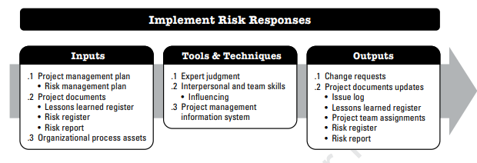
6 Implement Risk Responses
Implement Risk Responses is the process of implementing agreed-upon risk response plans.

Slide 23
Steps in Implementing Risk Responses
Assign Risk Owners.
Integrate Risk Responses into Project Plans.
Communicate the Risk Response Plan.
Implement Risk Responses.
Verify that resources required for implementing responses are available and allocated appropriately.
Maintain a record of implemented responses for accountability and future reference.
Update Project Plans and Risk Register

Slide 24
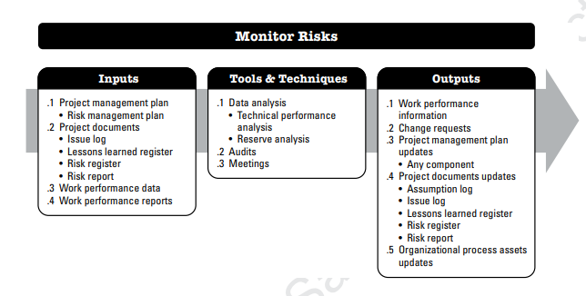
7 Monitor Risks
Monitor Risks is the process of monitoring the implementation of agreed-upon risk response plans, tracking identified risks, identifying and analyzing new risks, and evaluating risk process effectiveness throughout the project.

Slide 25
Steps for Monitoring Risks in Risk Management
Reassess the project environment to identify new risks or changes in existing risks.
Use the risk register to monitor the probability, impact, and status of each risk.
Evaluate whether risk responses are working as intended.
Maintain a risk register or risk log to document and update risks.
Compare actual project outcomes with planned objectives to detect deviations.
Perform Reserve Analysis: Evaluate whether contingency and management reserves are sufficient.
Assess how well implemented risk responses are working.
Gather feedback from stakeholders and team members.
Analyze whether risk impacts have been mitigated as planned.
Modify or update risk responses if they are found ineffective.

Slide 26
7 Monitor Risks
Audits:
Risk audits are a type of audit that may be used to consider the effectiveness of the risk management process.
The project manager is responsible for ensuring that risk audits are performed at an appropriate frequency, as defined in the project’s risk management plan.
The format for the risk audit and its objectives should be clearly defined before the audit is conducted.

Slide 27
Reading Assignment
Chapter 11: Project Risk Management by PMBOK-Guide-6th-Edition-PMI
(Book and Lecture Slides are already uploaded on resource link.)

